Slide 1
THE COMPUTER SYSTEM
[Function & Interconnections]

Slide 2
Lecture Objectives
Computer functions
  Instruction fetch & execute
  Interrupt Handling
  I/O functions
Interconnections
Computer Components

Slide 3
Functional view of a computer- Prev
Data
Storage
Facility
Data
Movement
Apparatus
Control
Mechanism
Data
Processing
Facility

Slide 4
Components - Top Level [Preview]
Structure is the way the components are interrelated.
Peripherals
Computer
Central
Processing
Unit
Main
Memory
Computer
Systems
Interconnection
Input
Output
Communication
lines

Slide 5
Von Neumann Machine
The von Neumann architecture has been the basis for virtually all computer designs since the first generation.
Concepts/X-tics of the architecture.
    Data & Instructions stored in single read/Write memory
    Contents of this memory are addressable by location, regardless of the type of data
    Execution occurs in a sequential fashion (Unless explicitly modified) from one instruction to the next

Slide 6
Computer Components
The Control Unit and the Arithmetic Logic Unit constitute the Central Processing Unit
Data and instructions need to get into the system and results out
  Input/output
Temporary storage of instructions and results is needed
  Main memory

Slide 7
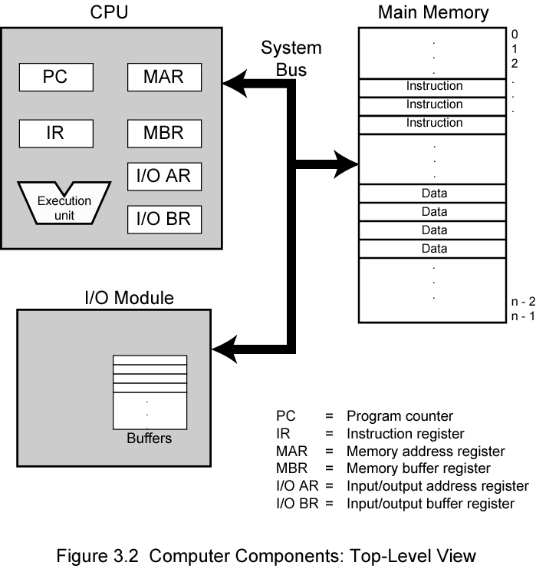
Computer Components and their Interconnection: Top Level View

Slide 8
The CPU exchanges data with memory and therefore makes use of the registers in the CPU.
Program Counter holds either the address of the instruction being executed, or the address of the next instruction to be executed.
The PC is Incremented after each instruction-fetch.
  Unless told otherwise
The fetched Instruction is loaded into the Instruction Register (IR). The instruction contains bits that specify the action the processor is to take.

Slide 9
MAR- stores the memory address from which data will be fetched to the CPU or the address to which data will be sent and stored.
MBR- Contains the data to be written into memory or receives the data read from memory
I/O AR- Specifies a particular I/O device.
I/O BR- Used for the exchange of data between an I/O module and the CPU.

Slide 10
Memory Module- Consists of a set of locations, defined by sequentially numbered addresses. Each location contains a binary number that can be interpreted as either an instruction or data.
I/O Module- Transfers data from external devices to memory and CPU and vice versa. It contains internal buffers for temporarily holding data until it can be sent on.

Slide 11
Instruction execution follows a set cycle
Determine the address of the next instruction
Fetch that instruction from memory
Decode the instruction to determine what is to be performed
Calculate the addresses of needed operands and
fetch the operands
Perform the operation on the operands
Store the results
Check for and service pending interrupts

Slide 12

Basic Instruction Cycle
Instruction Cycle: sequence of actions that the central processing unit (CPU) performs to execute each instruction.
Basic function performed by a computer is execution of instructions, mainly done by the processor. Execution/processing consists of Two steps:
  Fetch (read from memory)
  Execute
These processes are continuously repeated. The processing required for a single instruction is called an instruction cycle.

Slide 13
Fetch Cycle
The two steps are referred to as the fetch and execute cycle.
At the beginning of each instruction cycle, the processor fetches an instruction from memory.

Slide 14
Execute Cycle
Processor interprets instruction and performs required actions. The actions are categorized into:
Processor-memory
  data transfer between CPU and main memory & vice versa.
Processor- I/O
  Data transfer between CPU and I/O module
Data processing
  Arithmetic or logical operation on data by CPU
Control
  Alteration of sequence of operations

Slide 15
Interrupts
  Mechanism by which other modules (e.g. I/O) may interrupt normal processing of the cpu.
  Classes of interrupts
    Program
      e.g. overflow, division by zero

Slide 16
Cont’d Interrupts
Timer
  Generated by internal processor timer
  Used in pre-emptive multi-tasking: allows OS to perform certain functions
I/O
  From I/O controller: may signal normal completion of an operation or signals an error condition
Hardware failure
  e.g. memory parity error (used to detect memory corruption between the time that data is written to memory and the time that it is read back)

Slide 17
Interrupt Cycle
To accommodate interrupts, an interrupt cycle is added to instruction cycle
In the Interrupt Cycle, The Processor checks for interrupt occurance.
  Indicated by an interrupt signal
If no interrupts are pending, The processor proceeds to fetch next instruction.
If an interrupt is pending,the processor does:

Slide 18
Cont’d
  Suspend execution of current program
  Save context
  Set PC to start address of interrupt handler routine
  Process interrupt
  Restore context and continue interrupted program

Slide 19

Instruction Cycle with Interrupts

Slide 20
Multiple Interrupts
A typical system can support several to several dozen interrupts.
How should the system respond if more than I interrupt occurs at the same time?
>> System prioritize the various interrupts.
>> At the start of the interrupt cycle, the highest priority pending interrupt will be serviced.
>>Remaining interrupt requests will be serviced in turn
..

Slide 21
Multiple Interrupts
Eg . A program receiving data from a communication line and printing results. The commn line controller will generate an interrupt whenever a unit of data arrives.
Can be handled by disabling them or by defining priorities.

Slide 22
Handling Multiple Interrupts
Define priorities
  Low priority interrupts can be interrupted by higher priority interrupts.
  When a higher priority interrupt has been processed, processor returns to previous interrupt.
Disable interrupts ( processor ignores interrupt request signal)
  Processor will ignore further interrupts while processing one interrupt
  Interrupts remain pending and are checked after first interrupt has been processed
  Interrupts handled in sequence as they occur

Slide 23
Interconnection Structures
A computer consists of a set of components or modules of three basic types
  CPU
  Memory
  Input/Output.
  The collection of paths connecting the various modules is called the interconnection structure.
All these units must be connected to communicate with each other

Slide 24

Memory : The memory module consists of N words. Each word is assigned a unique numerical address. The nature of the operation is indicated by read and write control signals. The location for the operation is specified by an address.
Computer Modules

Slide 25
Memory
Receives and sends data
Receives control signals
  Read
  Write
  Timing

Slide 26
Input/Output (1)
Output
  Receive data from computer
  Send data to peripheral
Input
  Send data to computer
  We can refer to each of the interfaces to an external device as a port, each given a unique address.

Slide 27
Input/Output (2)
Receive control signals from computer
Send control signals to peripherals
Receive addresses from computer
  e.g. port number to identify peripheral
Send interrupt signals (control)

Slide 28
I/O Module

Slide 29
CPU
Reads instructions and data
Writes out data (after processing)
Sends control signals to other units
Receives (& acts on) interrupts

Slide 30
Processor

Slide 31
Data to be exchanged
The interconnection structure must support the following types of transfers
Memory to Processor -Processor reads instructions from memory.
Processor to Memory -Processor writes data to memory.
I/O to Processor -Processor reads data from I/O device via the I/O module.
Processor to I/O -Processor sends data to I/O device.
I/O to or from memory - I/O module is allowed to exchange data directly with memory without going through the processor using DMA.

Slide 32
Bus Interconnection: What is a Bus?
A communication pathway connecting two or more devices
Key characteristic of a bus-it is a shared transmission medium.
Multiple devices connect to the bus, and a signal transmitted by any one device is available for reception by all other devices attached to the bus.
Consists of multiple communication lines, each capable of transmitting signals representing binary 1 or 0

Slide 33
Bus Structure
A bus consists of a number of separate lines each assigned a particular function.
These Bus lines are classified into three functional groups:
  Data
  Address and
  Control lines

Slide 34
Data Line Bus
These lines provide a pathway for moving data between system modules and are collectively called the data bus.
Data bus is a computer subsystem that allows for the transferring of data from one component to another on a motherboard or system board, or between two computers. This can include transferring data to and from the memory, or from the central processing unit (CPU) to other components.
Function- Carries data
  Remember that there is no difference between “data” and “instruction” at this level.

Slide 35
Data Lines (Continued)
Each line can carry only one bit at a time, the number of lines determines how many bits can be transferred at a time.

Slide 36
Address Lines
Address bus transfers information about where the data should go
Function- Used to designate the source or destination of data on the data bus.
E.g. if CPU needs to read an instruction (data) from a given location in memory it puts the address of the desired data on the address lines.
Address lines are also used to address the I/O ports.
Bus width determines maximum memory capacity of system

Slide 37
Control Lines
Carry control information between the CPU and other devices within the computer.
Function- Used to control the access to and the use of the data and address lines. This is because the data and address lines are shared by all components there must be a means of controlling their use.
  Memory write signal: Causes data on the bus to be written into the addressed location.
  Memory read: Causes data from the addressed location to be placed on the bus.
  Request for Bus usage.
  Interrupt request Signal
  Clock signals: Used to synchronize operations
  Reset: Initializes all modules.
  Signals for malfunction.
.

Slide 38
Control Lines
Control signals transmit both command and timing information between system modules.
Timing signals indicate validity of address and data information. These signals coordinate the rate at which signal bits are sent & received at the communicating modules.

Slide 39

Bus Interconnection Scheme

Slide 40
Control Lines.
Command signals specify operations to be performed.
Control lines include the following:
  Memory read/write
  I/O read/write
  Transfer ACK-indicates acceptance of data from or placed on bus
  Bus request- module needs to gain bus control
  Bus grant- requesting module granted bus control
  Interrupt request- pending interrupt
  Clock signals- used to synchronise operations
  Reset- initialise all modules

Slide 41
Bus operation
If one module wishes to send data to another, it must do the following:
1. Obtain the use of the bus and
2. Transfer data via the bus
If one module wishes to request data from another module it must:
1. Obtain the use of the bus and
2. Transfer a request to the other module over the appropriate control and address lines. It must then wait for the second module to send data

Slide 42
Single Bus Problems
Lots of devices on one bus leads to:
  Propagation delays due to greater bus length
    Long data paths mean that co-ordination of bus use can adversely affect performance
  The bus may become a bottleneck as the aggregate data transfer approaches bus capacity. Can be dealt with by increasing data rate that the bus can carry
Most systems use multiple buses to overcome these problems

Slide 43
Bus Type
Dedicated( Permanently assigned either to one function or to a physical subset of computer components.
  Eg used of separate dedicated data & address lines
Multiplexed( Same line for multiple purposes)
  Shared lines
  Address valid or data valid control line
  Advantage - fewer lines
  Disadvantages.
    More complex control
    Ultimate performance

Slide 44
Bus Arbitration
Process of insuring only one device places information onto the bus at a time.
>> Master – Slave Mechanism
Master is given control of the bus and can place information onto it.
Slave receives the information from the master.

Slide 45
More than one module controlling the bus
e.g. CPU and DMA controller
Only one module may control bus at one time
Arbitration may be centralised or distributed

Slide 46
Centralized . Central bus controller mediates for the bus
Decentralized . No centralized controller. All devices contain logic to control access to the bus.

